Slide 1
Discrete Mathematics
Spring 2020
Yuan Ze University

Slide 2
Maximum bipartite matching

Slide 3
Bipartite graphs

Slide 4
A matching

Slide 5
Non-matching

Slide 6
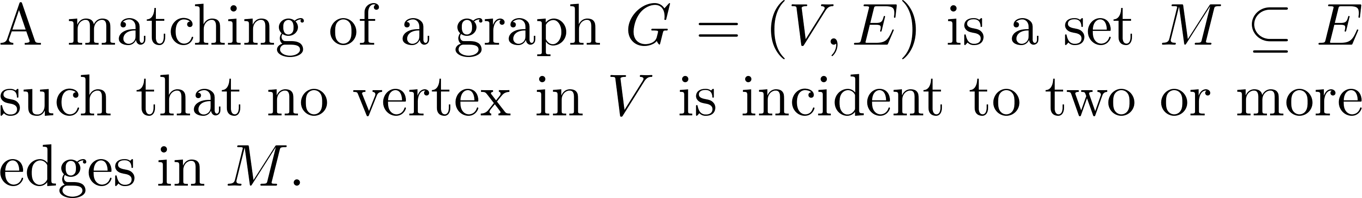
Formally…

Slide 7
An algorithmic problem

Slide 8
A maximum matching

Slide 9
How to find a maximum matching?
Start from any matching and enlarge it whenever possible.

Slide 10
A way of enlarging a matching
Remove the solid edges and pick up the dashed ones

Slide 11
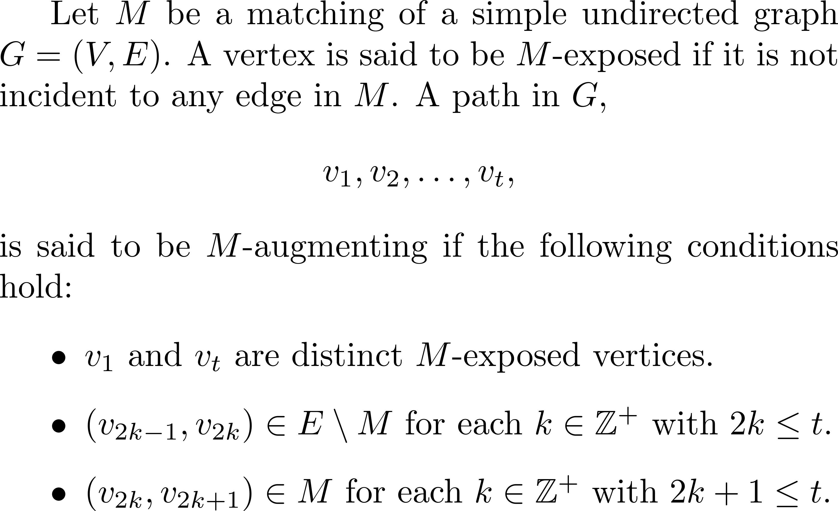
Augmenting paths ☺

Slide 12
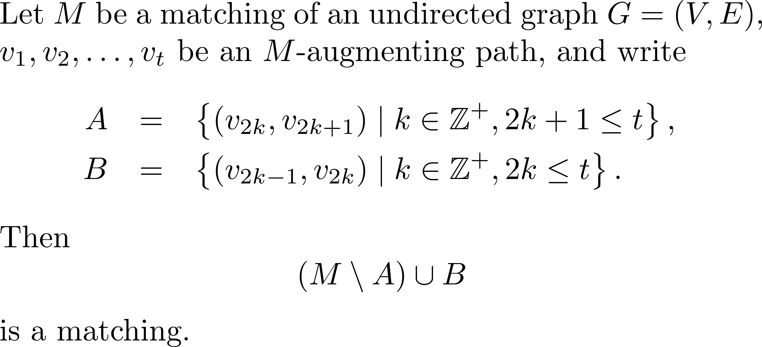
Observation

Slide 13
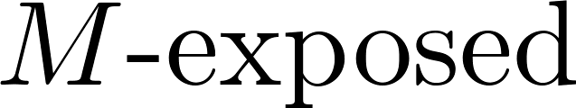
Why? (1/2)

Slide 14
Why? (2/2)
Still a matching!

Slide 15
Proved!

Slide 16
Furthermore…
The matching is enlarged!

Slide 17
Enlarged?
An M-augmenting path
has more edges not in M
than in M…

Slide 18
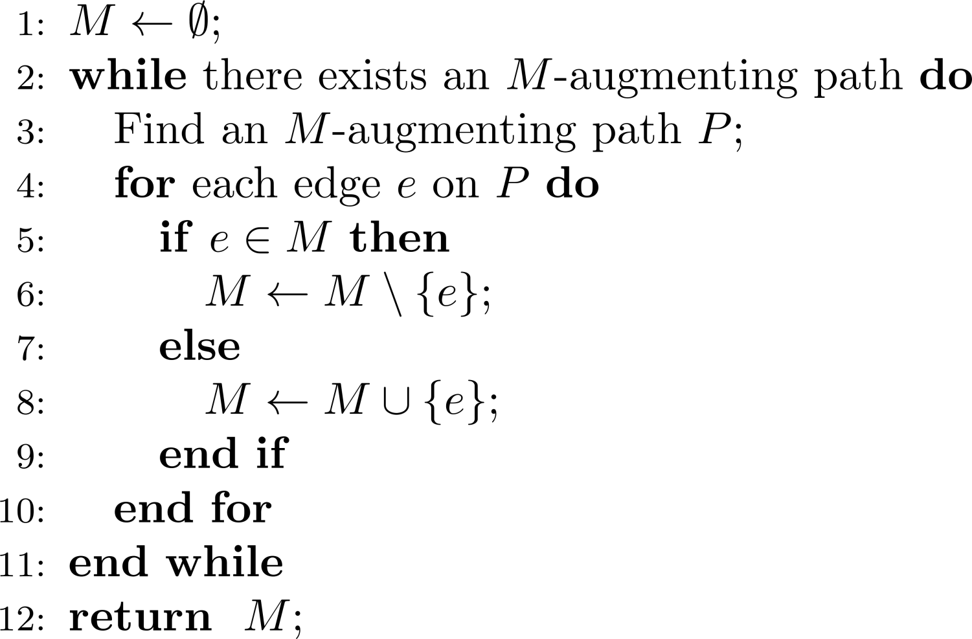
Back to our strategy…
Start from any matching and enlarge it whenever possible.

Slide 19
What is missing?
Possible that a matching is non-maximum yet there are no augmenting paths?

Slide 20
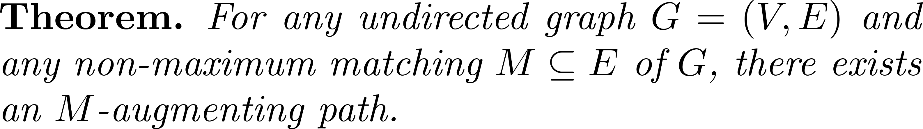
Gladly…

Slide 21
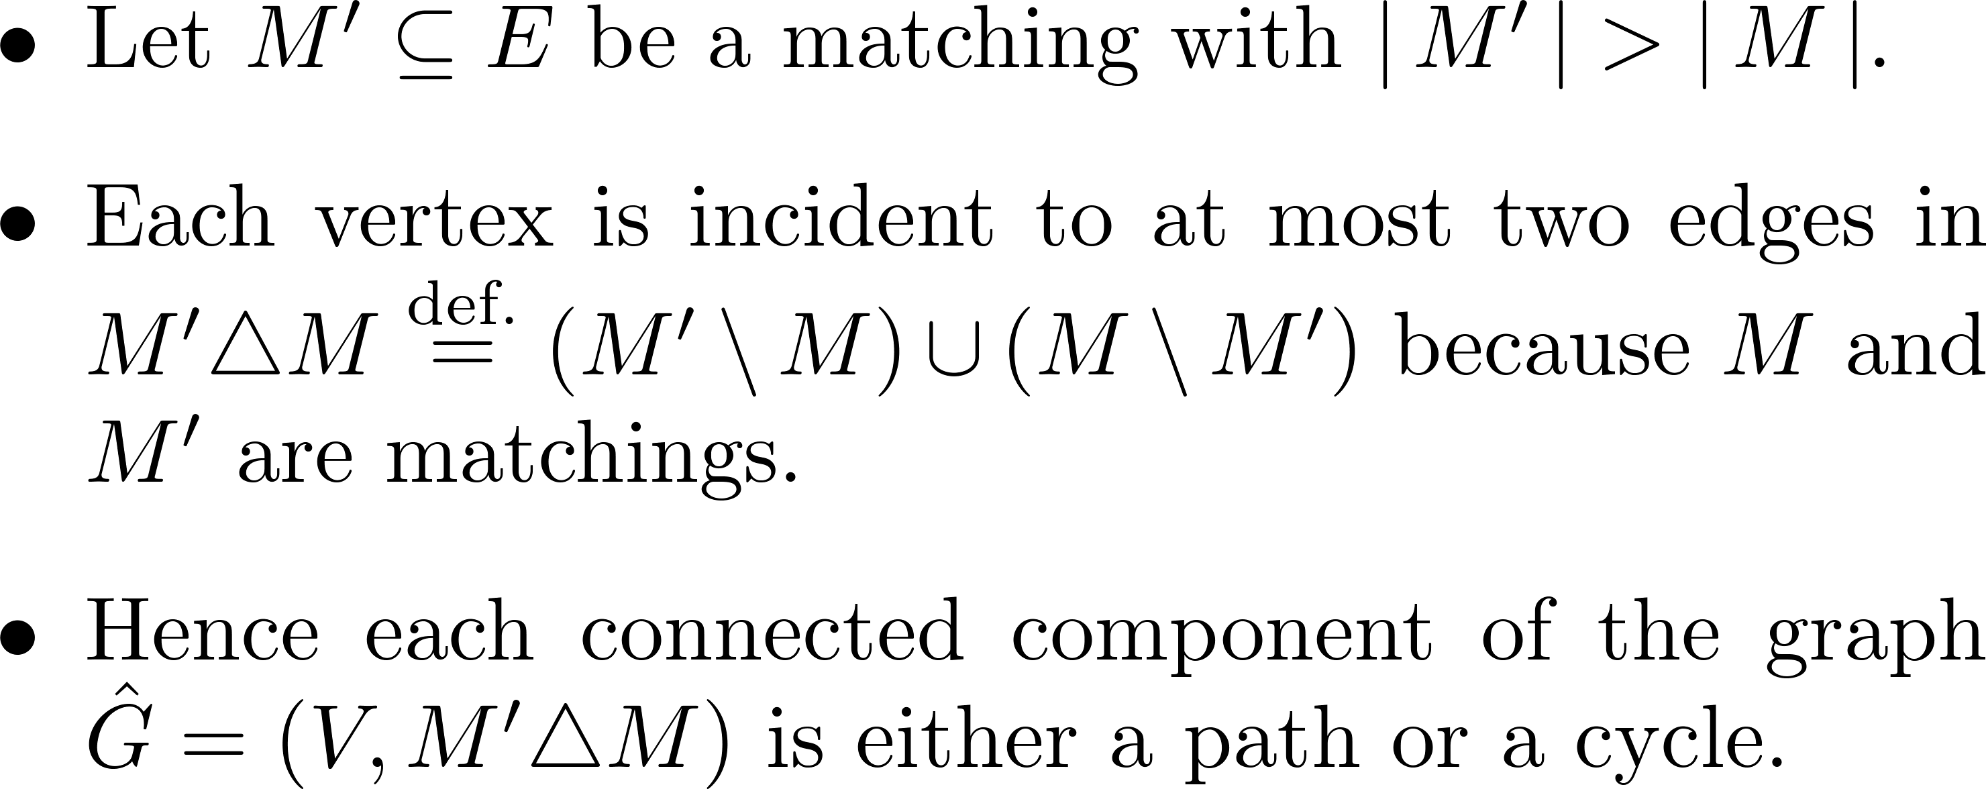
Proof (1/3)

Slide 22
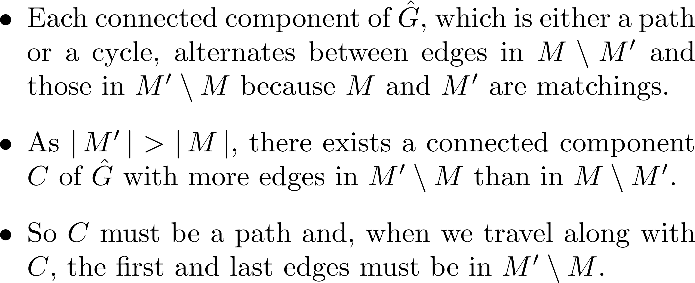
Proof (2/3)

Slide 23
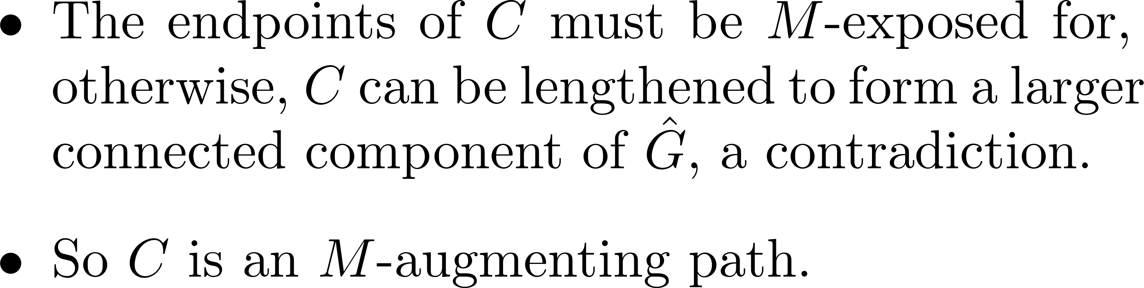
Proof (3/3)

Slide 24

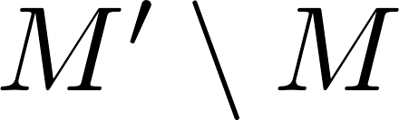
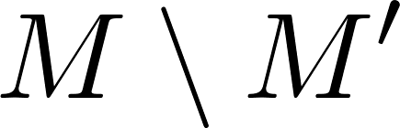
Illustration

Slide 25
We used this…
Left as exercise.

Slide 26
Proved!

Slide 27
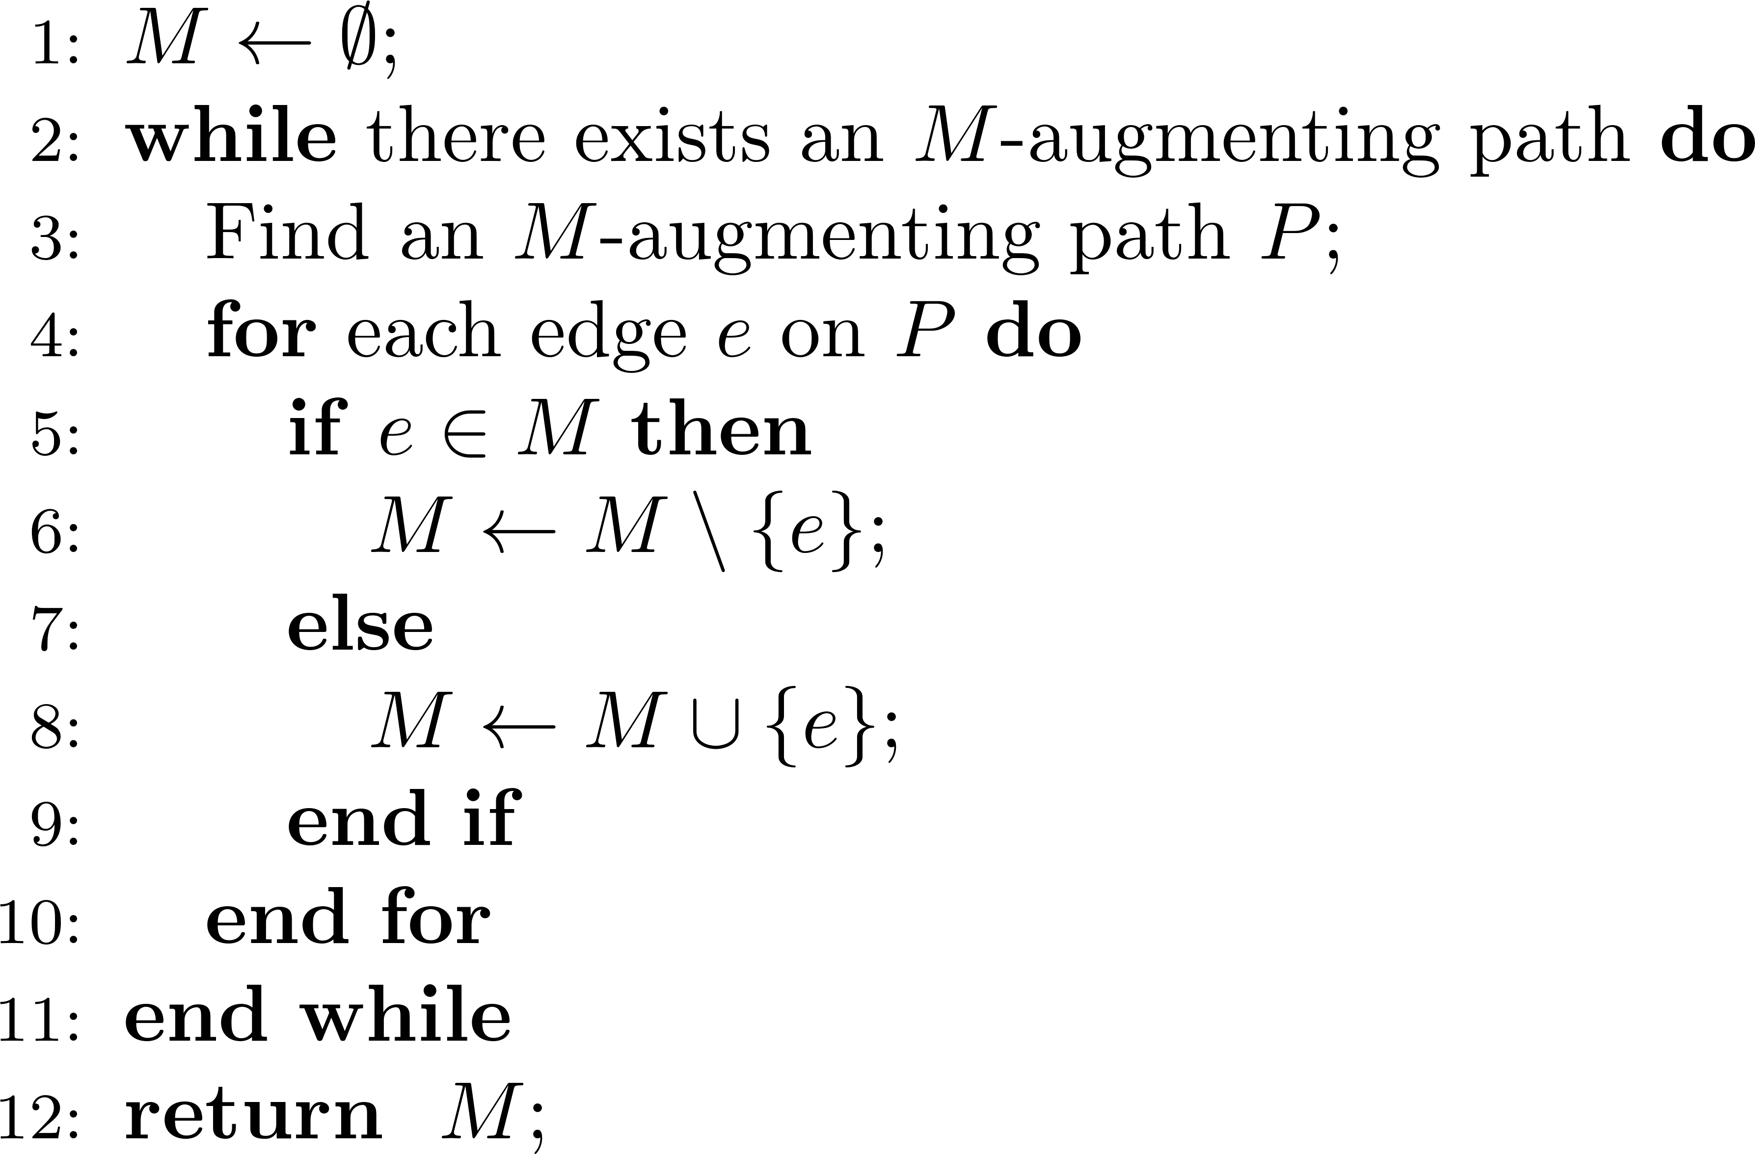
How to find a maximum matching

Slide 28
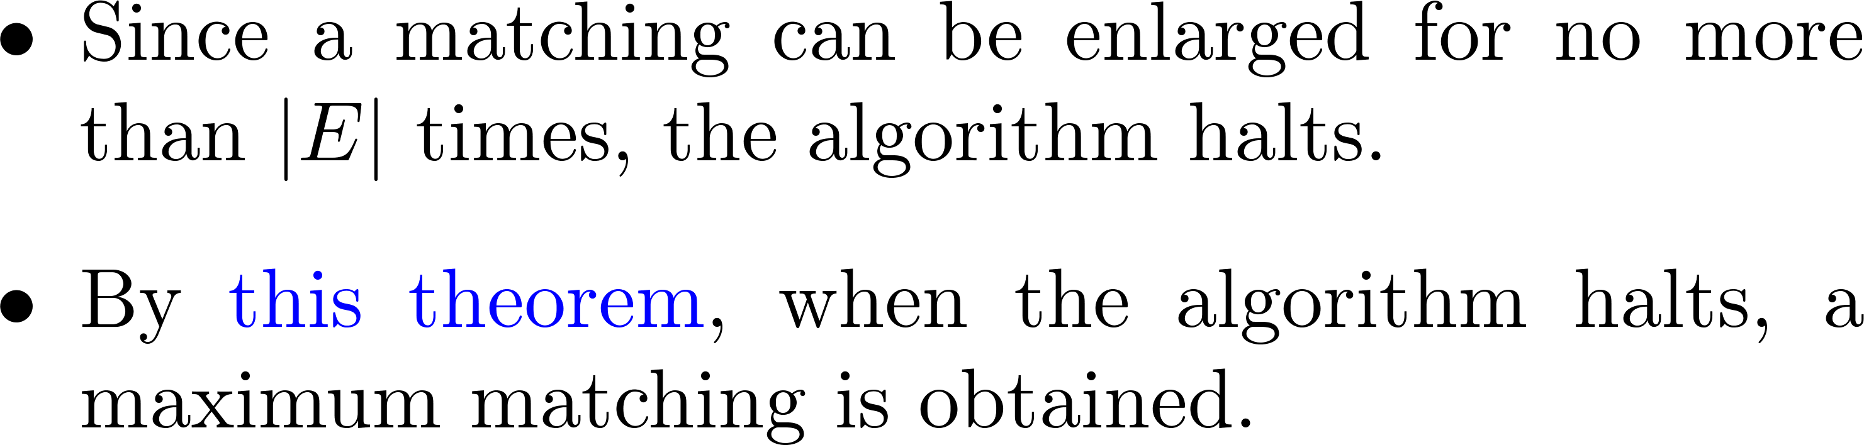
Correctness
_________________

Slide 29
So…
We omit the analysis on the time complexity of finding an augmenting path.

Slide 30
A hard problem
Given a bipartite graph, find its number of perfect matchings.
A matching is perfect if it has no exposed vertices.
Known to be #P-complete.

Slide 31
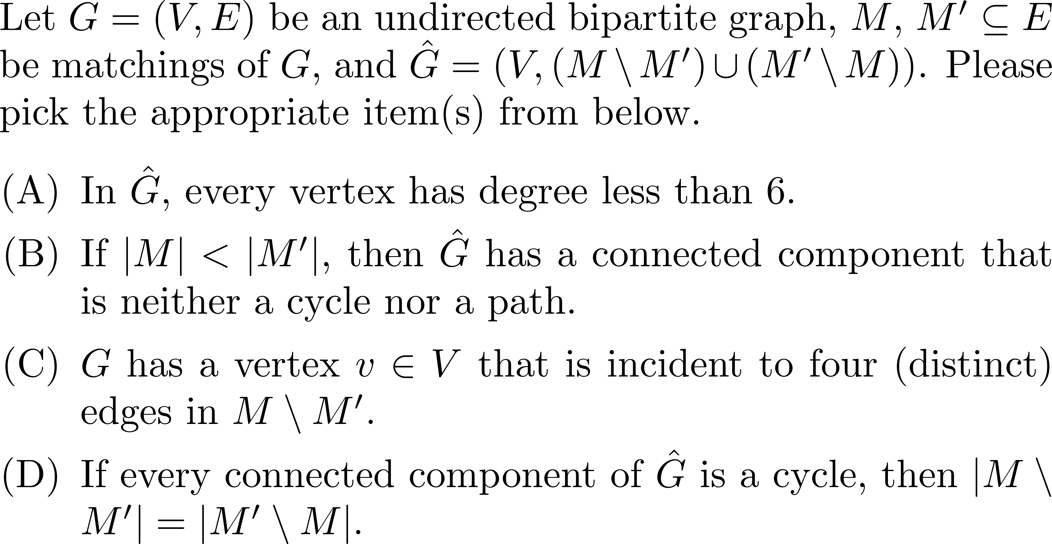
Exercise (1/2)

Slide 32
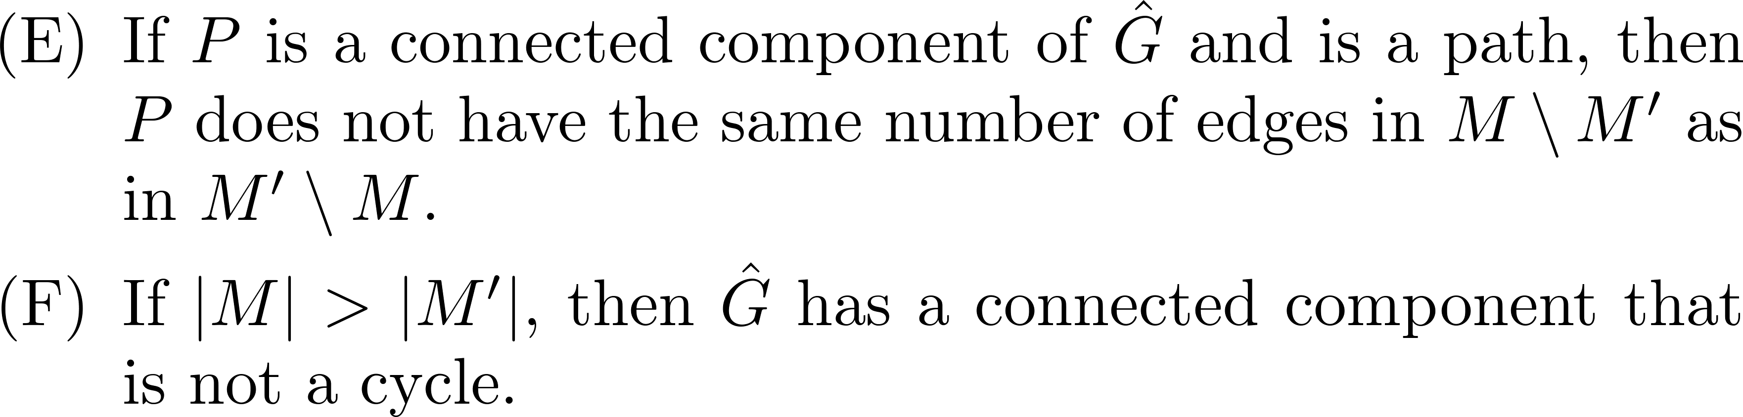
Exercise (2/2)

Slide 33
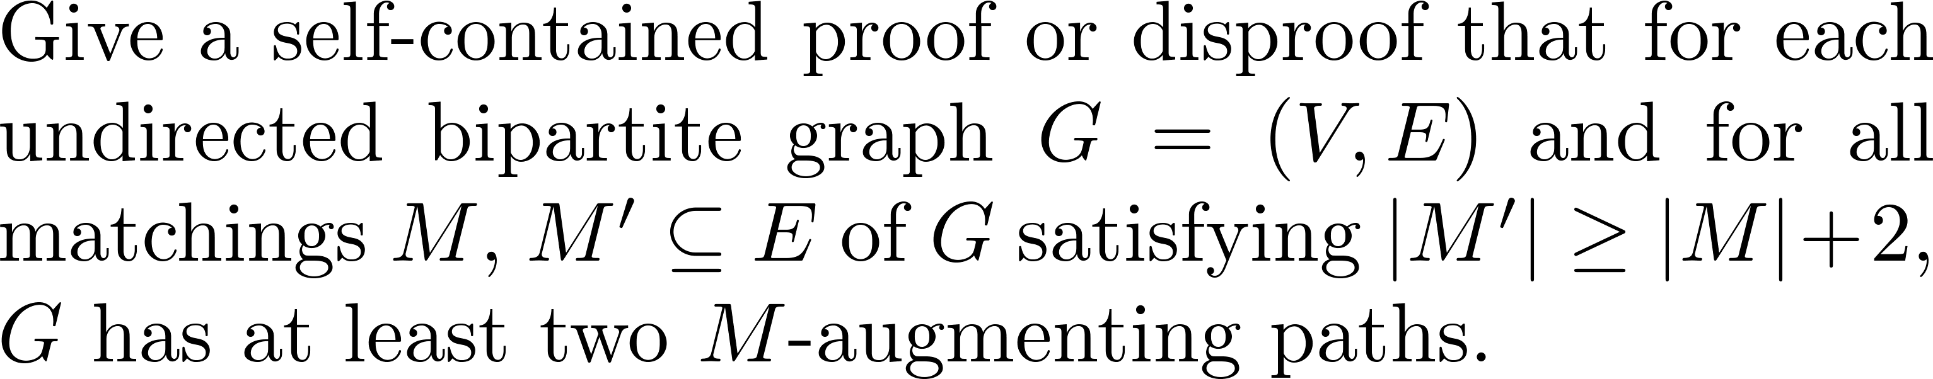
Exercise

Slide 34
Questions and comments?

